Slide 1
Data mining for Business Analytics
Association Rule & K-Means Clustering
ISOM3360
Lab 7

Slide 2
Unsupervised Learning
Without a Target Variable
Relationship mining
Hard to perform evaluation
Q: How do I find attributes/items that occur together more than I might expect by chance?
A: Associations (relationship between columns)
Q: How do I find natural groupings of data instances?
A: Clustering (relationship between rows/examples)

Slide 3
Association Rule Mining
Association rule mining
Finding frequent patterns, associations, correlations among sets of items in transaction (or event) databases.
Applications:
Market-basket analysis, cross-selling marketing, web log analysis, fraud detection, recommender system…

Slide 4
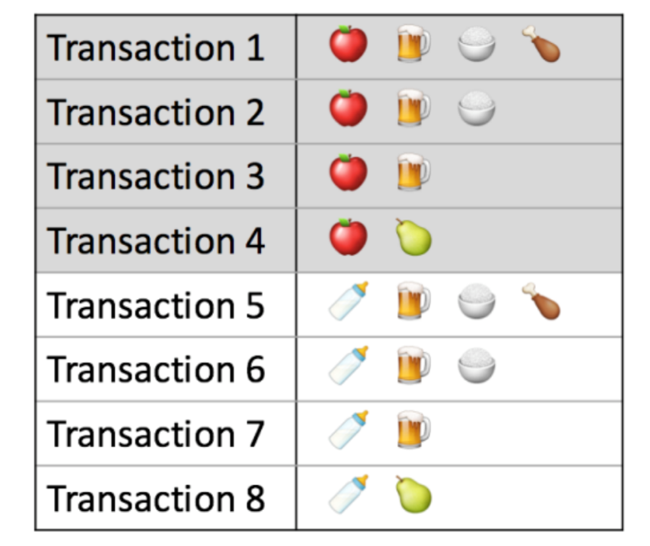
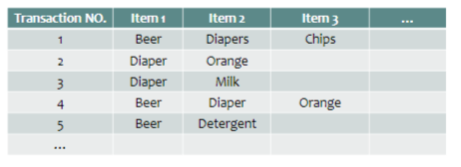
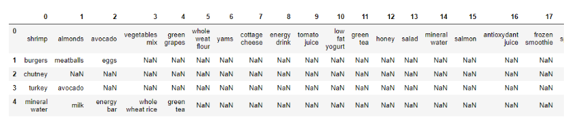
Dataset format for Association Rule
Items List, A comma-delimited item list in a single column.

Slide 5
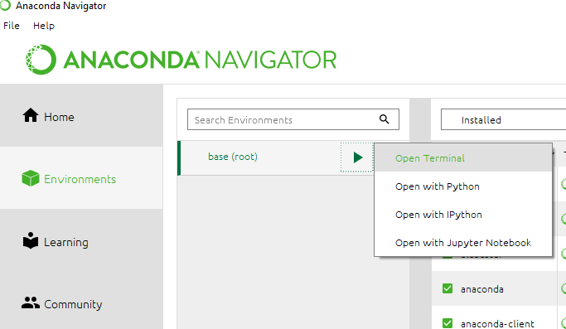
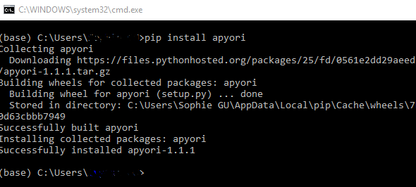
Install Apyori library
Go to your “Anaconda” navigator and click ‘Environments’ and base(root) → open terminal
Do a pip install for apyori by typing in “pip install apyori”

Slide 6
Data Preprocessing
The Apriori library we are going to use requires our dataset to be in the form of a list of lists, where the whole dataset is a big list and each transaction in the dataset is an inner list within the outer big list.
[["apple", "banana", "cherry"]
["milk", "banana", "cherry"]
["apple", "banana", “bread"]
…
["milk", "banana", “bread"]]
Convert from pandas data frame into a list of lists, execute the following script:
records = [] # create a list to store transaction records
for i in range (0,7500): # there are in total 7501 transactions
records.append([str(dataset.values[i,j]) for j in range (0,19)]) # there are in total 20 items

Slide 7
Applying Apriori
Import Apriori
Create association rules
Association Rule parameters
min_support: select the items with support values greater than the value specified
min_confidence: filters those rules that have confidence greater than the confidence threshold specified
min_lift: minimum lift value for the short listed rules
max_length: the maximum number of items that you want in your rules
# import apriori algorithm
from apyori import apriori
association_rules = apriori(records,
min_support=0.0045,
min_confidence=0.2,
min_lift=3,
max_length=5)
association_results = list(association_rules)

Slide 8
Viewing the Results
Find the total number of rules mined
View single rule
Light Cream → Chicken
Itemset = {light cream, chicken}, Items_base = {light cream}, Items_add = {chicken}
Support = (Itemset)/7500
Confidence = Support (Itemset) / Support of (Items_base)
Lift = Confidence/ Support of (Items_add)
print(len(association_results))
print(association_results[0])

Slide 9
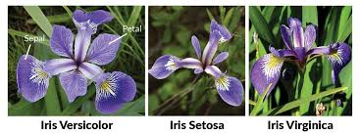
K-Means Clustering
Clustering: Group Iris Data
This dataset has 150 samples with 4 features and 1 Label (the last column). All features are numeric variables while Label is a categorical variable

Slide 10
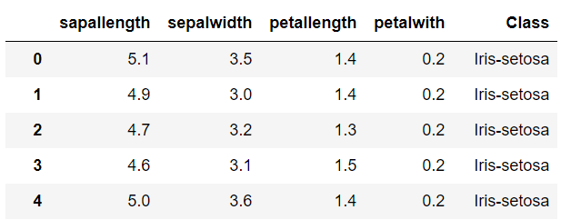
Unsupervised learning – Iris Example
Remember the unsupervised learning is not involving predicting of the value for target variable, If we use all 5 attributes to conduct the clustering analysis, is it meaningful?
Then, we may change our question as follow:
Is it possible to use the 4 attributes (sapallength, sepalwidth, petallength and petalwidth) to create 3 Iris groups, so that we can use this model in the future to identify new iris according to the 4 attributes?
In the following experiment, as we know the actual class for each instance, we can do a simple split and try to test the clustering model on the testing set

Slide 11
Data preparation
Select all attributes except ‘Class’ as the features
We will need to build the clustering model using features only, ‘Class’ is used for evaluation purpose later
Split the data into 60/40
features = ['sapallength','sepalwidth','petallength','petalwith']
X = Iris [features]
y = Iris ['Class']
from sklearn.model_selection import train_test_split
X_train, X_test, y_train, y_test = train_test_split(X, y, test_size=0.4, random_state = 42)

Slide 12
Unsupervised learning – Iris Example
Split the data into 60/40
Use 60% data to train a cluster model with K = 3, get the centroids for each cluster (cluster 0, cluster 1 and cluster 2).
Use majority classification to map each clusters to different Iris type
Apply the cluster model and assign 40% data to corresponding cluster

Slide 13

Build clustering model on training data
Import Kmeans
Set no. of cluster, K=3
Fit data, Use 60% data to train a cluster model
Parameters for Kmeans Clustering
n_clusters:The number of clusters to form as well as the number of centroids to generate.
init: Method for initialization
n_init: Number of time the k-means algorithm will be run with different centroid seeds. The final results will be the best output of n_init consecutive runs in terms of inertia.
max_iter: um number of iterations of the Maximk-means algorithm for a single run.
# import KMeans from sklearn
from sklearn.cluster import KMeans
# set number of cluster to be 3
kmeansmodel = KMeans(n_clusters=3)
# fit data
kmeansmodel.fit(X_train)

Slide 14

Get info about the clustering result
Cluster Centroids
Number of iteration
Sum of squared distances of samples to their closest cluster center
Distance to each cluster centroid
# centroids
centroids = kmeansmodel.cluster_centers_
# centroids
interation = kmeansmodel.n_iter_
# SSD
SSD = kmeansmodel.inertia_
# centroids
distance = kmeansmodel.transform(X_train)
distance

Slide 15
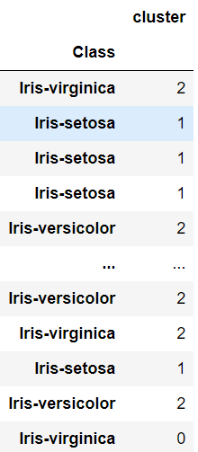
Label the class to different cluster
Get Labels of each point in 60% training data
Create comparison table between actual class and predict cluster
Find corresponding instances that belong to each Iris type
Count value for different cluster regarding one type of Iris
train_label = kmeansmodel.labels_
trainlabels=pd.DataFrame(labels,y_train,columns=['cluster'])
trainlabels
Iris_virginica = trainlabels.loc['Iris-virginica']
Iris_setosa = trainlabels.loc['Iris-setosa']
Iris_versicolor = trainlabels.loc['Iris-versicolor']
Iris_virginica[Iris_virginica.columns[0]].value_counts()
Iris_setosa[Iris_setosa.columns[0]].value_counts()
Iris_versicolor[Iris_versicolor.columns[0]].value_counts()

Slide 16
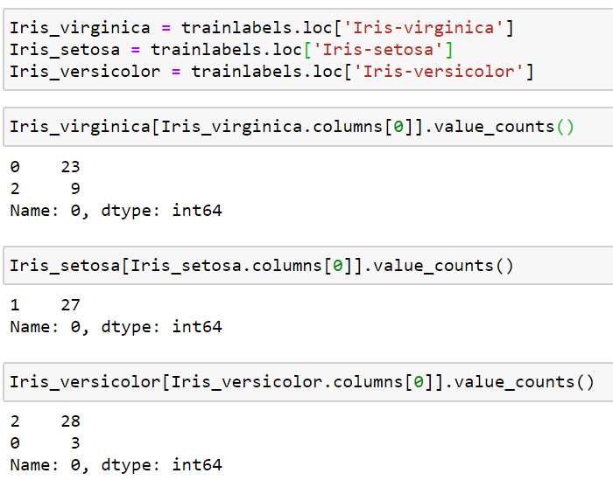
Label the class to different cluster
Based on majority rule, we will map each cluster to different iris type
Cluster 0: Iris_viginica
Cluster 1: Iris_Sentosa
Cluster 2: Iris_versicolor

Slide 17
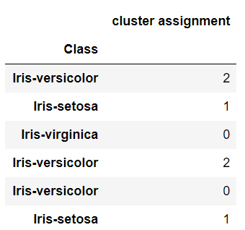
Predict labels for testing data
Predicted labels from testing
Create comparison table between actual class and predict cluster
Create comparison tables for different type of Iris
Count value for different cluster regarding one type of Iris
testlabels = kmeansmodel.predict(X_test)
testlabels
testdata=pd.DataFrame(testlabels,y_test, ,columns=['cluster assignment'])
testdata
Iris_virginica_test = testdata.loc['Iris-virginica']
Iris_setosa_test = testdata.loc['Iris-setosa']
Iris_versicolor_test = testdata.loc['Iris-versicolor']
Iris_virginica_test[Iris_virginica_test.columns[0]].value_counts()
Iris_setosa_test[Iris_setosa_test.columns[0]].value_counts()
Iris_versicolor_test[Iris_versicolor_test.columns[0]].value_counts()

Slide 18
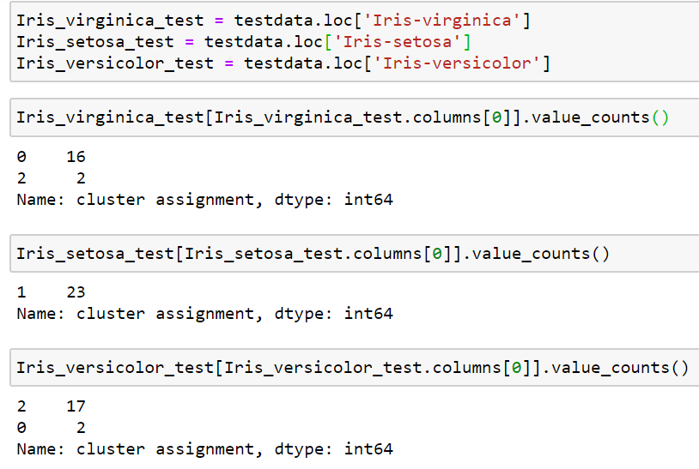
Evaluate the cluster assignment
There are in total 18 Iris_virginica in testing data, 16 of them have been assigned to Cluster 0, 2 of them have been assigned to Cluster 2. Remember what is Cluster 0 and Cluster 2 refer to in the previous training process?
You can use the same rational to interpret the other two Iris types, which kind of serve as confusion matrix.
Most of time when we do clustering, we do not expect a target variable in the data and the evaluation is hard to perform.

